Slide 1

“Title of Project ”
BANSAL INSTITUTE OF SCIENCE AND TECHNOLOGY BHOPAL (M.P)
DEPARTMENT OF COMPUTER SCIENCE AND ENGINEERING
B.Tech. In Computer Science and Engineering
Session APR-2023
Presented By:
GROUP MEMBERS
1. Rahul Gupta
2. Satynadra kr. Saket
3. Rahi Turkar
4. Gagan Bisen
5. Ankit Kr. Chaubey
HOD
Prof. Manish Saxena
(Asst. Professor, Dept. of CSE, B.I.S.T., Bhopal)
PROJECT INCHARGE:
Prof.
(Asst. Professor, Dept. of CSE,
B.I.S.T., Bhopal)

Slide 2
Content
Abstract
Introduction
Implemented Methodologies
Simulation Results
Conclusion and Future Scope
References

Slide 3
Abstract
Auctions are processes where selling and buying of products takes place by offering them for a bid and the buyer with the highest bid price buys the product or the seller with lowest ask price sells the product.

Slide 4
Introduction
Online auction systems are a major component of the electronic commerce space which have an ever-increasing popularity. In these systems, a seller uploads a product online for a given set amount of time and the buyers with the highest bid purchases the product.

Slide 5
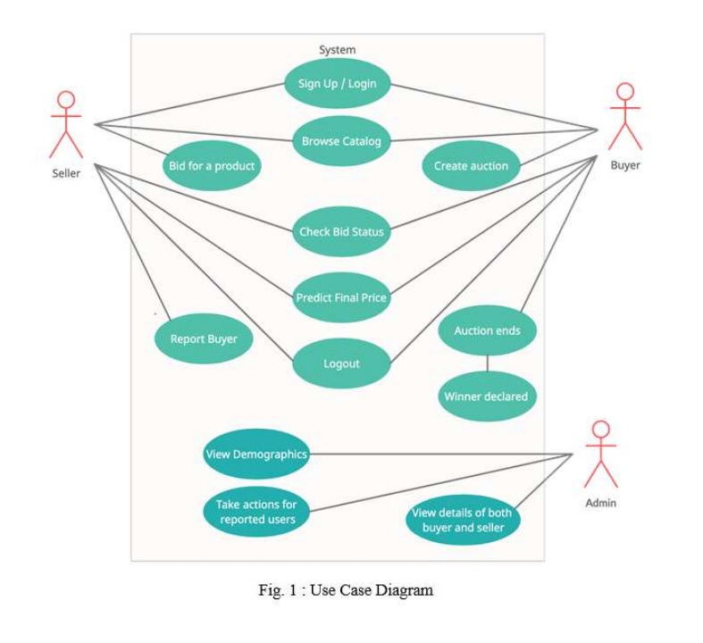
Use case diagram

Slide 6
IMPLEMENTED METHODOLOGIES
HTML
CSS
JAVASCRIPT
DJANGO
PYTHON
HEROKU

Slide 7
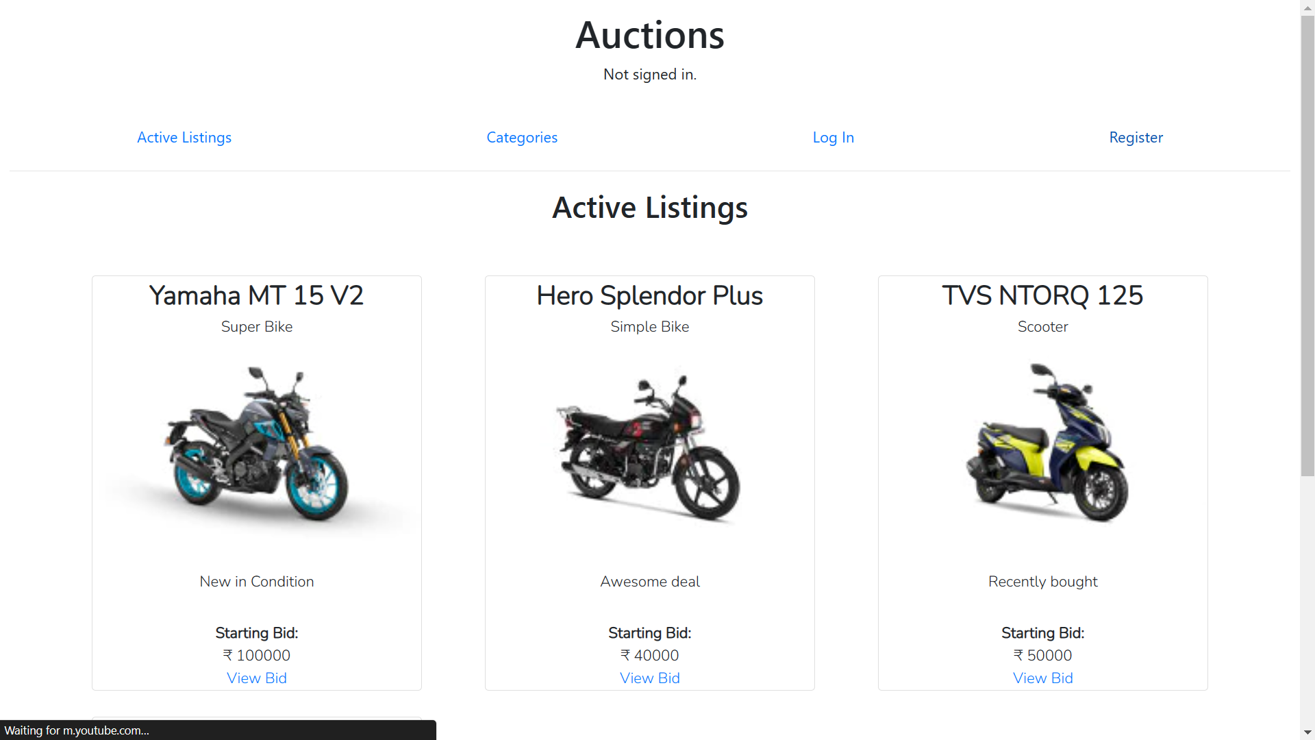
SIMULATION RESULT

Slide 8
Conclusion
A safe place to buy and sell second hand product.
Instant deal with quality inspection.
Complete billing and document varification.

Slide 9
Future Scope
Proper other classified web app – API integration.
Payment Integration.
Invoice on mail integration.

Slide 10
References
Geek For Geeks
Udemy
Youtube
Github

Slide 11
THANK YOU

